Slide 1
6
Bones and Skeletal Tissues: Part A

Slide 2
Cartilage: Basic Structure, Types and Locations
Skeletal cartilage
  Water lends resiliency n.跳回(回弹；弹力；弹性变形；冲击值)
  Contains no blood vessels or nerves
  Perichondrium surrounds
    Dense connective tissue girdlegirdle
      Contains blood vessels for nutrient delivery
      Resists outward expansion
© 2013 Pearson Education, Inc.

Slide 3
Skeletal Cartilages
All contain chondrocytes in lacunae 空隙 and extracellular matrix
Three types
  Hyaline cartilage
    Provides support, flexibility, and resilience适应力；弹性
    Collagen fibers only; most abundant type
    Articular 关节的, costal 肋骨的, respiratory, nasal cartilage
  Elastic cartilage
    Similar to hyaline cartilage, but contains elastic fibers
    External ear and epiglottis喉头盖
  Fibrocartilage
    Thick collagen fibers—has great tensile 可伸展的 strength
    Menisci of knee 膝盖半月板; vertebral discs
© 2013 Pearson Education, Inc.

Slide 4
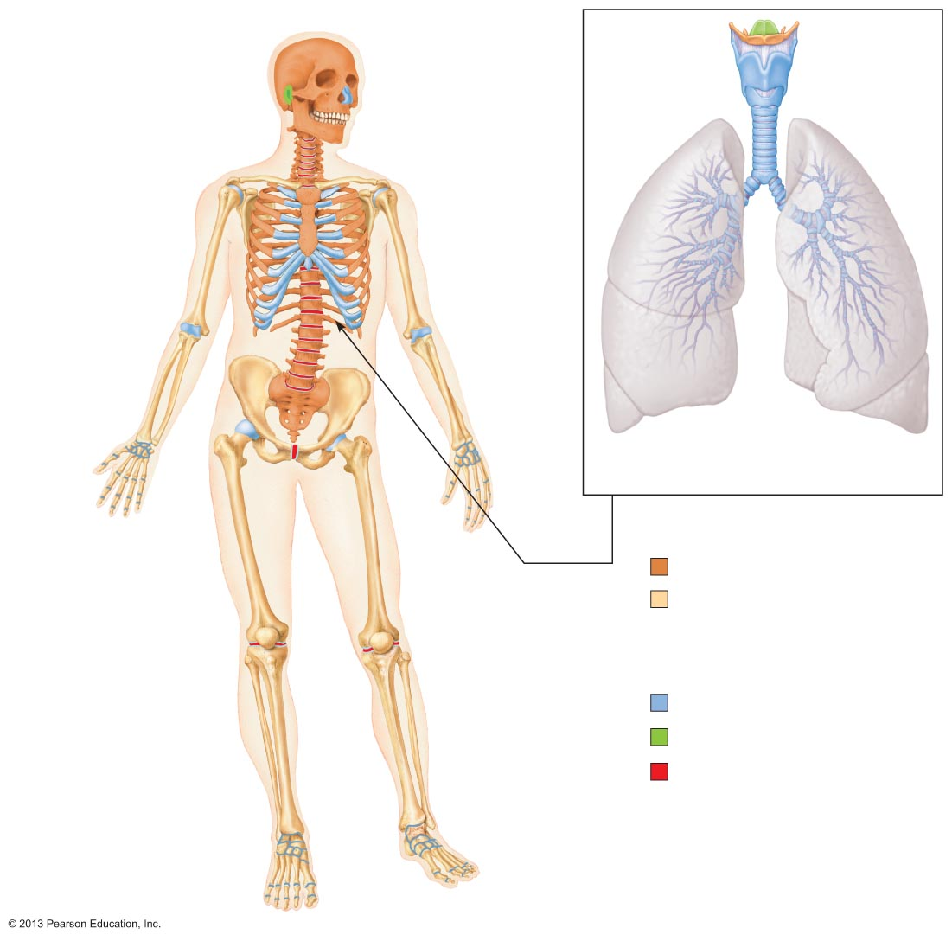
Figure 6.1 The bones and cartilages of the human skeleton.
Epiglottis
Thyroid
cartilage
Larynx
Cartilage in
external ear
Cartilages in
nose
Cricoid
cartilage
Trachea
Articular
cartilage
of a joint
Lung
Costal
cartilage
Cartilage in
intervertebral
disc
Respiratory tube cartilages
in neck and thorax
Pubic
symphysis
Bones of skeleton
Axial skeleton
Meniscus
(padlike cartilage
in knee joint)
Appendicular skeleton
Cartilages
Articular
cartilage of a joint
Hyaline cartilages
Elastic cartilages
Fibrocartilages
© 2013 Pearson Education, Inc.

Slide 5
Growth of Cartilage
Appositional 同位格的 growth
  Cells secrete matrix against external face of existing cartilage
Interstitial 空隙的 growth
  Chondrocytes divide and secrete new matrix, expanding cartilage from within
Calcification 钙化 of cartilage
  Occurs during normal bone growth
    Youth and old age
  Hardens (使)变硬, but cacified cartilage is not bone
© 2013 Pearson Education, Inc.

Slide 6
Classification of Bones
206 named bones in skeleton
Divided into two groups
  Axial skeleton
    Long axis of body
    Skull, vertebral column, rib cage
  Appendicular skeleton
    Bones of upper and lower limbs
    Girdles 围绕物 attaching limbs to axial skeleton
© 2013 Pearson Education, Inc.

Slide 7
Figure 6.1 The bones and cartilages of the human skeleton.
Epiglottis
Thyroid
cartilage
Larynx
Cartilage in
external ear
Cartilages in
nose
Cricoid
cartilage
Trachea
Articular
cartilage
of a joint
Lung
Costal
cartilage
Cartilage in
intervertebral
disc
Respiratory tube cartilages
in neck and thorax
Pubic
symphysis
Bones of skeleton
Axial skeleton
Meniscus
(padlike cartilage
in knee joint)
Appendicular skeleton
Cartilages
Articular
cartilage of a joint
Hyaline cartilages
Elastic cartilages
Fibrocartilages
© 2013 Pearson Education, Inc.

Slide 8
Classification of Bones by Shape
Long bones
Short bones
Flat bones
Irregular bones
© 2013 Pearson Education, Inc.

Slide 9
Classification of Bones by Shape
Long bones
  Longer than they are wide
  Limb, wrist, ankle 踝关节 bones
Short bones
  Cube-shaped 立方体形的 bones (in wrist and ankle)
  Sesamoid 种子骨的 bones (within tendons, e.g., Patella 膝盖骨)
  Vary in size and number in different individuals
Flat bones
  Thin, flat, slightly curved
  Sternum, scapulae, ribs, most skull bones
  胸骨， 肩胛骨，肋骨，头骨
Irregular bones
  Complicated shapes
  Vertebrae, coxal bones 椎骨，臀部的骨头
© 2013 Pearson Education, Inc.

Slide 10
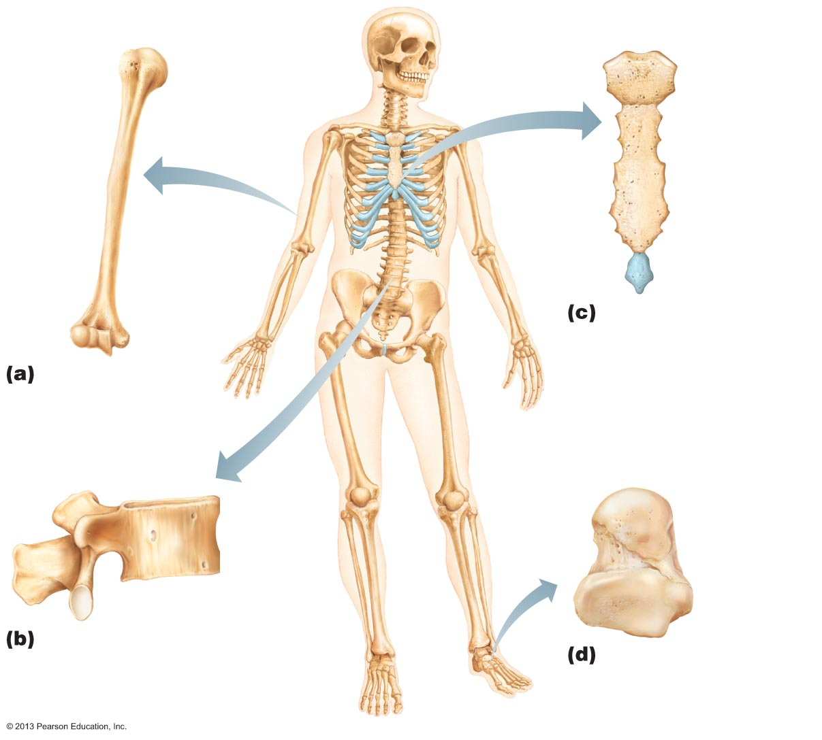
Figure 6.2 Classification of bones on the basis of shape.
Flat bone (sternum)
Long bone
(humerus)
Irregular bone (vertebra),
right lateral view
Short bone (talus)
© 2013 Pearson Education, Inc.

Slide 11
Functions of Bones
Seven important functions
  Support
  Protection
  Movement
  Mineral and growth factor storage
  Blood cell formation
  Triglyceride甘油三酯 (fat) storage
  Hormone production
© 2013 Pearson Education, Inc.

Slide 12
Functions of Bones
Support
  For body and soft organs
Protection
  For brain, spinal cord, and vital organs
Movement
  Levers for muscle action
© 2013 Pearson Education, Inc.

Slide 13
Functions of Bones
Mineral and growth factor storage
  Calcium and phosphorus 磷, and growth factors reservoir
Blood cell formation (hematopoiesis 造血) in red marrow cavities of certain bones
Triglyceride (fat) storage in bone cavities
  Energy source
Hormone production
  Osteocalcin 骨钙素
    Regulates bone formation
    Protects against obesity, glucose intolerance, diabetes mellitus肥胖，糖尿病, 糖尿病
© 2013 Pearson Education, Inc.

Slide 14
Bones
Are organs
  Contain different types of tissues
    Bone (osseous) tissue, nervous tissue, cartilage, fibrous connective tissue, muscle and epithelial cells in its blood vessels
Three levels of structure
  Gross anatomy
  Microscopic
  Chemical
© 2013 Pearson Education, Inc.

Slide 15
Gross Anatomy
Bone textures 骨纹理
  Compact and spongy bone
Compact
  Dense outer layer; smooth and solid
  Spongy海绵 (cancellous松质骨or trabecular骨小梁)
  Honeycomb 蜂窝状 of flat pieces of bone deep to compact called trabeculae
© 2013 Pearson Education, Inc.

Slide 16
Structure of Short, Irregular, and Flat Bones
Thin plates of spongy bone covered by compact bone
Plates sandwiched between connective tissue membranes
  Periosteum骨膜 (outer layer) and endosteum骨内膜
No shaft or epiphyses骨骺
Bone marrow骨髓 throughout spongy bone; no marrow cavity
Hyaline cartilage covers articular关节 surfaces
© 2013 Pearson Education, Inc.

Slide 17
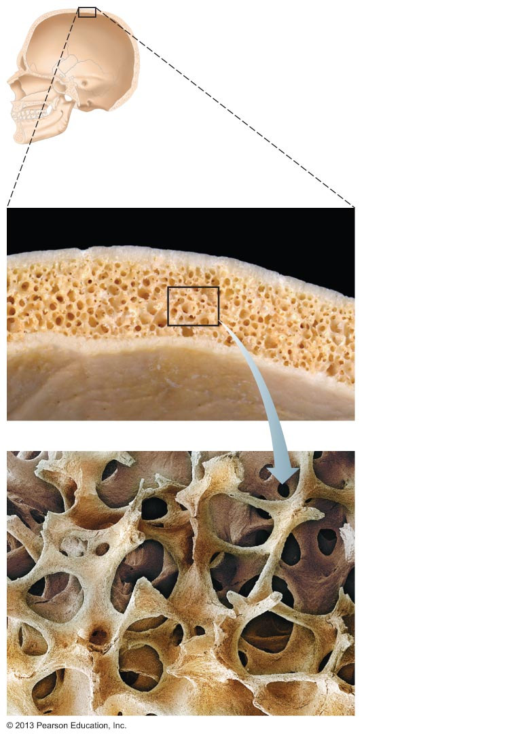
Figure 6.3 Flat bones consist of a layer of spongy bone sandwiched between two thin layers of compact bone.
Spongy bone
(diploë)
Compact
bone
Trabeculae of
spongy bone
© 2013 Pearson Education, Inc.

Slide 18
Structure of Typical Long Bone
Diaphysis骨干
  Tubular管状轴 shaft forms long axis
  Compact bone surrounding medullary cavity髓腔
Epiphyses骨骺
  Bone ends
  External compact bone; internal spongy bone
  Articular cartilage covers articular surfaces
  Between is epiphyseal line
    Remnant残余 of childhood bone growth at epiphyseal plate
© 2013 Pearson Education, Inc.

Slide 19
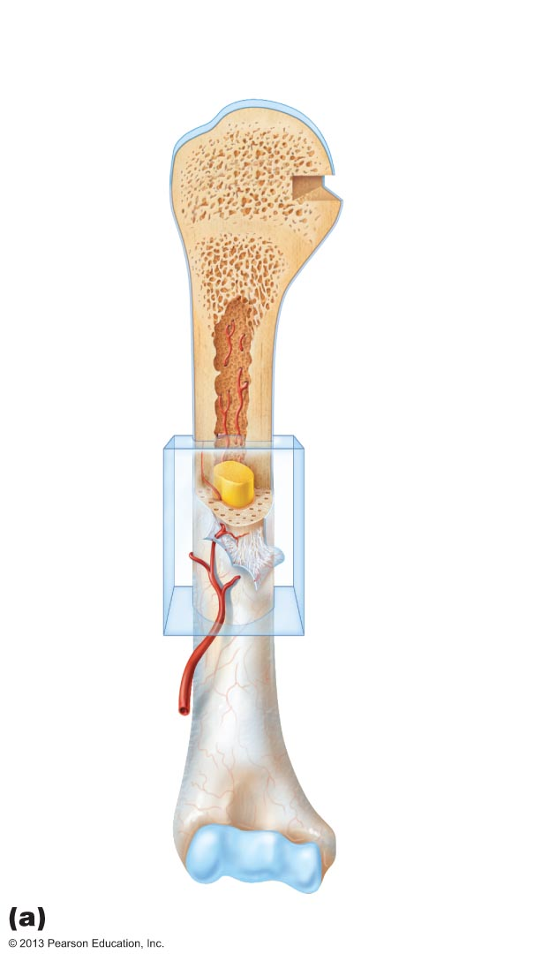
Figure 6.4a The structure of a long bone (humerus of arm).
Articular
cartilage
Proximal
epiphysis
Spongy bone
Epiphyseal
line
Periosteum
Compact bone
Medullary
cavity (lined
by endosteum)
Diaphysis
Distal
epiphysis
© 2013 Pearson Education, Inc.

Slide 20
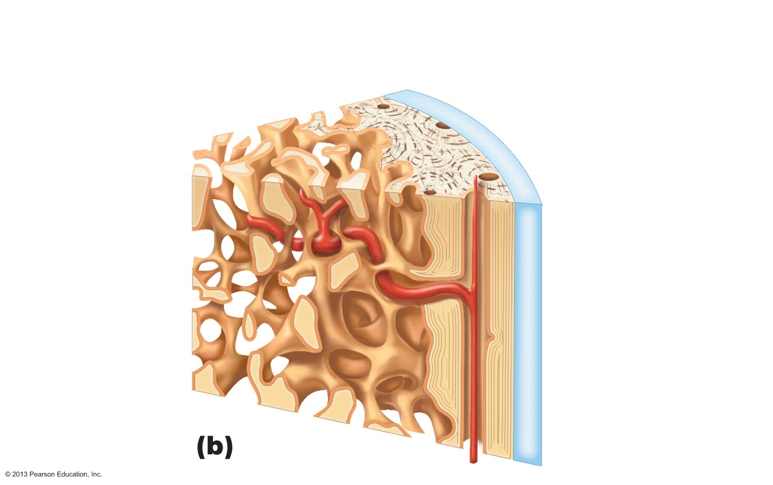
Figure 6.4b The structure of a long bone (humerus of arm).
Articular
cartilage
Compact bone
Spongy bone
Endosteum
© 2013 Pearson Education, Inc.

Slide 21
Membranes: Periosteum
White, double-layered membrane
Covers external surfaces except joint surfaces
Outer fibrous layer of dense irregular connective tissue
  Sharpey's fibers 骨纤维 secure 使安全 to bone matrix
Osteogenic layer 生骨层 abuts 毗连 bone
  Contains primitive stem cells – osteogenic cells
Many nerve fibers and blood vessels
Anchoring 锚定 points for tendons and ligaments
© 2013 Pearson Education, Inc.

Slide 22
Membranes: Endosteum
Delicate纤细的 connective tissue membrane covering internal bone surface
Covers trabeculae [解剖学]小梁 of spongy bone
Lines canals that pass through compact bone
Contains osteogenic 生骨的 cells that can differentiate into other bone cells
© 2013 Pearson Education, Inc.

Slide 23
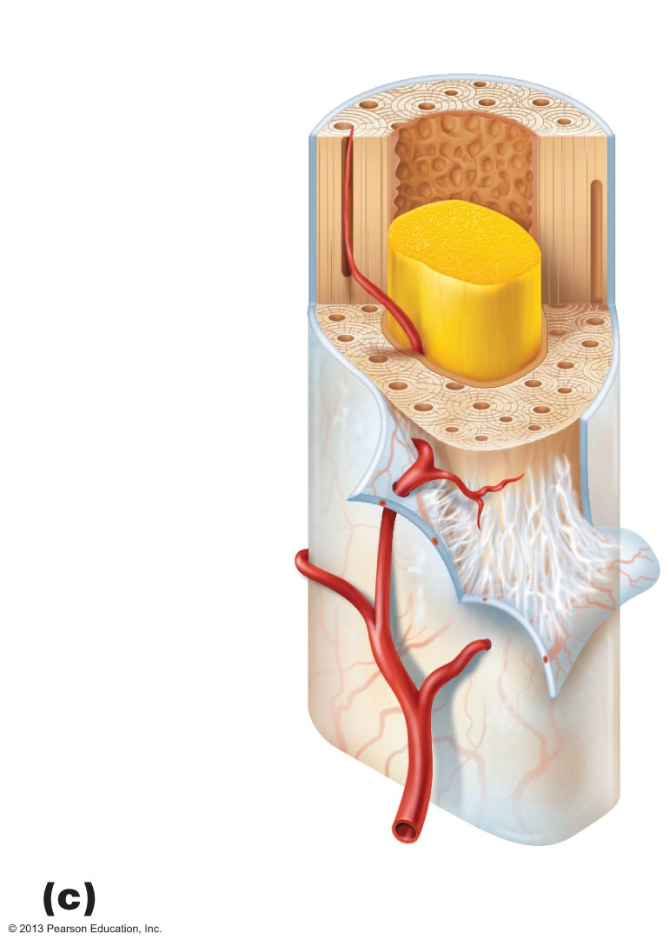
Figure 6.4c The structure of a long bone (humerus of arm).
Endosteum
Yellow
bone marrow
Compact bone
Periosteum
Perforating
(Sharpey’s)
fibers
Nutrient
arteries
© 2013 Pearson Education, Inc.

Slide 24
Hematopoietic 造血的 Tissue in Bones
Red marrow红骨髓
  Found within trabecular cavities of spongy bone and diploë of flat bones (e.g., sternum 胸骨)
  In medullary cavities 骨髓腔 and spongy bone of newborns
  Adult long bones have little red marrow
    Heads of femur 股骨 and humerus 肱骨 only
  Red marrow in diploë and some irregular bones is most active
  Yellow marrow can convert to red, if necessary
© 2013 Pearson Education, Inc.

Slide 25
Bone Markings
Sites of muscle, ligament, and tendon attachment on external surfaces
Joint surfaces
Conduits 导管 for blood vessels and nerves
Projections投影图
Depressions坳陷
Openings
© 2013 Pearson Education, Inc.

Slide 26
Bone Markings
Projections
  Most indicate stresses created by muscle pull or joint modifications
    Depressions and openings
    Usually allow nerves and blood vessels to pass
© 2013 Pearson Education, Inc.

Slide 27
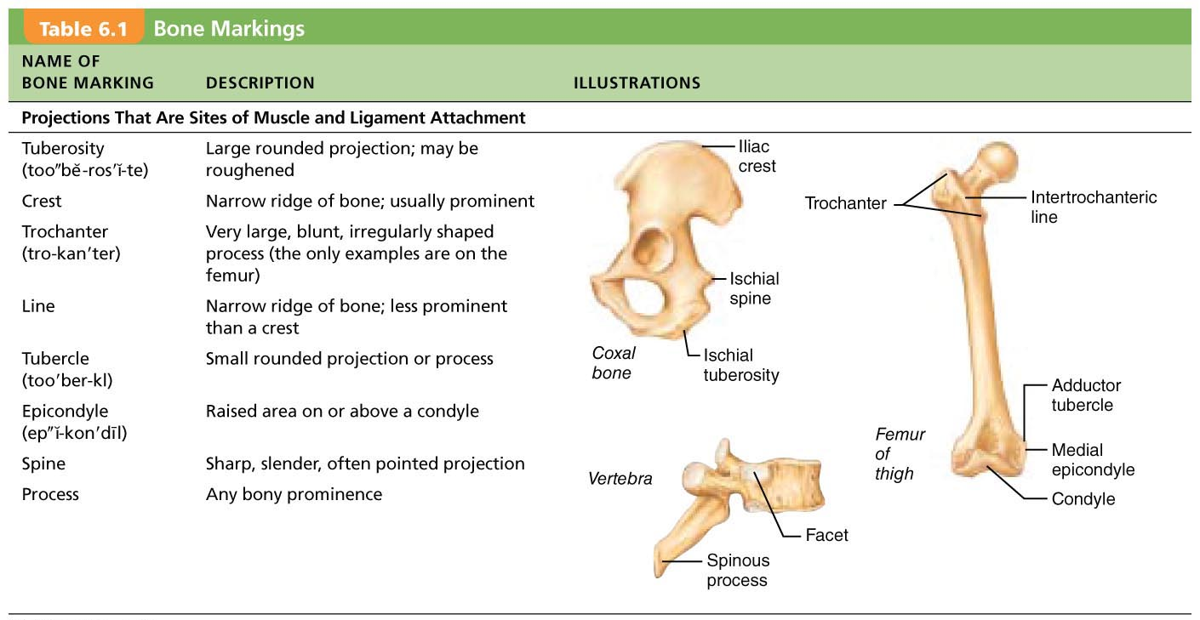
Table 6.1 Bone Markings (1 of 2)
© 2013 Pearson Education, Inc.

Slide 28
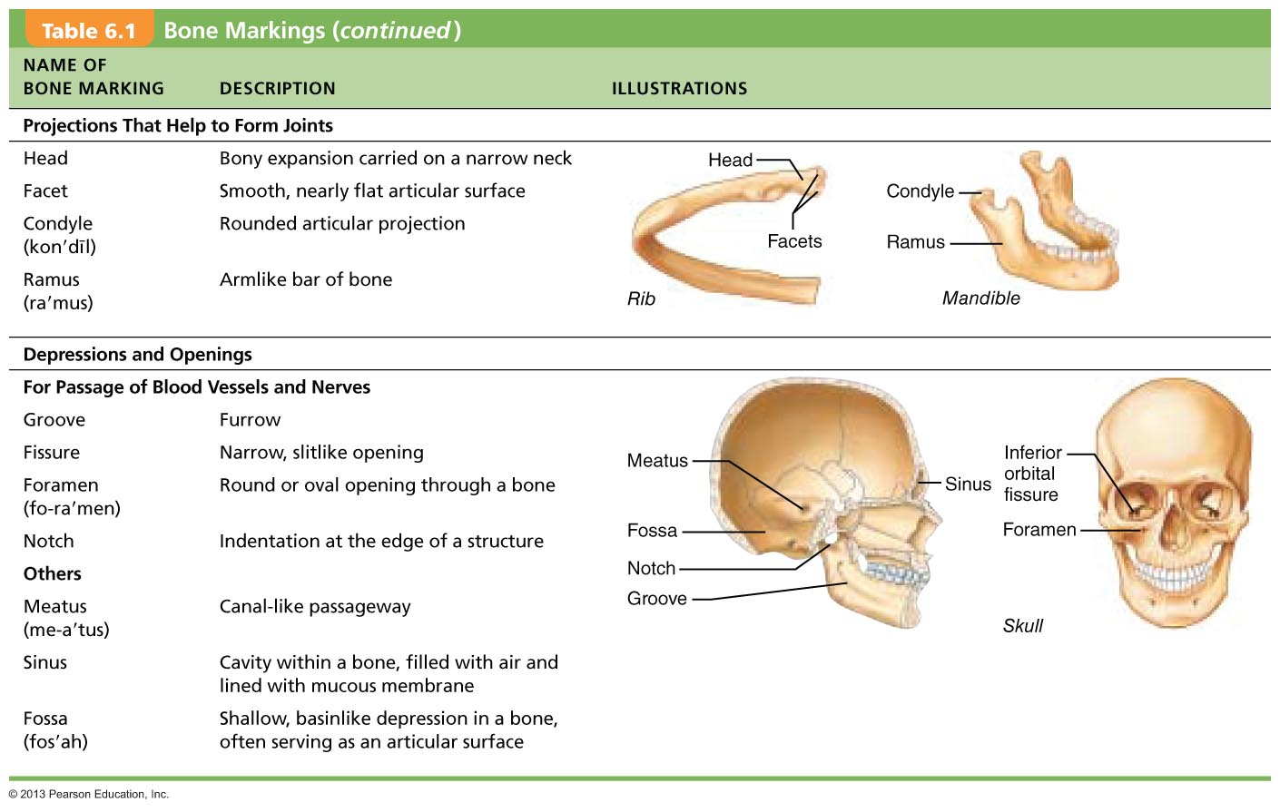
Table 6.1 Bone Markings (2 of 2)
© 2013 Pearson Education, Inc.

Slide 29
Microscopic Anatomy of Bone: Cells of Bone Tissue
Five major cell types
Each specialized form of same basic cell type
  Osteogenic cells
  Osteoblasts
  Osteocytes
  Bone lining cells
  Osteoclasts
© 2013 Pearson Education, Inc.

Slide 30
Osteogenic Cells
Also called osteoprogenitor cells
  Mitotically 有丝分裂 active stem cells in periosteum 骨膜 and endosteum 骨内膜
  When stimulated differentiate into osteoblasts or bone lining cells
    Some persist 坚持 as osteogenic cells
© 2013 Pearson Education, Inc.

Slide 31
Osteoblasts
Bone-forming cells
Secrete unmineralized bone matrix or osteoid
  Includes collagen and calcium-binding proteins
    Collagen = 90% of bone protein
Actively mitotic[生]有丝分裂的；间接核分裂的
© 2013 Pearson Education, Inc.

Slide 32
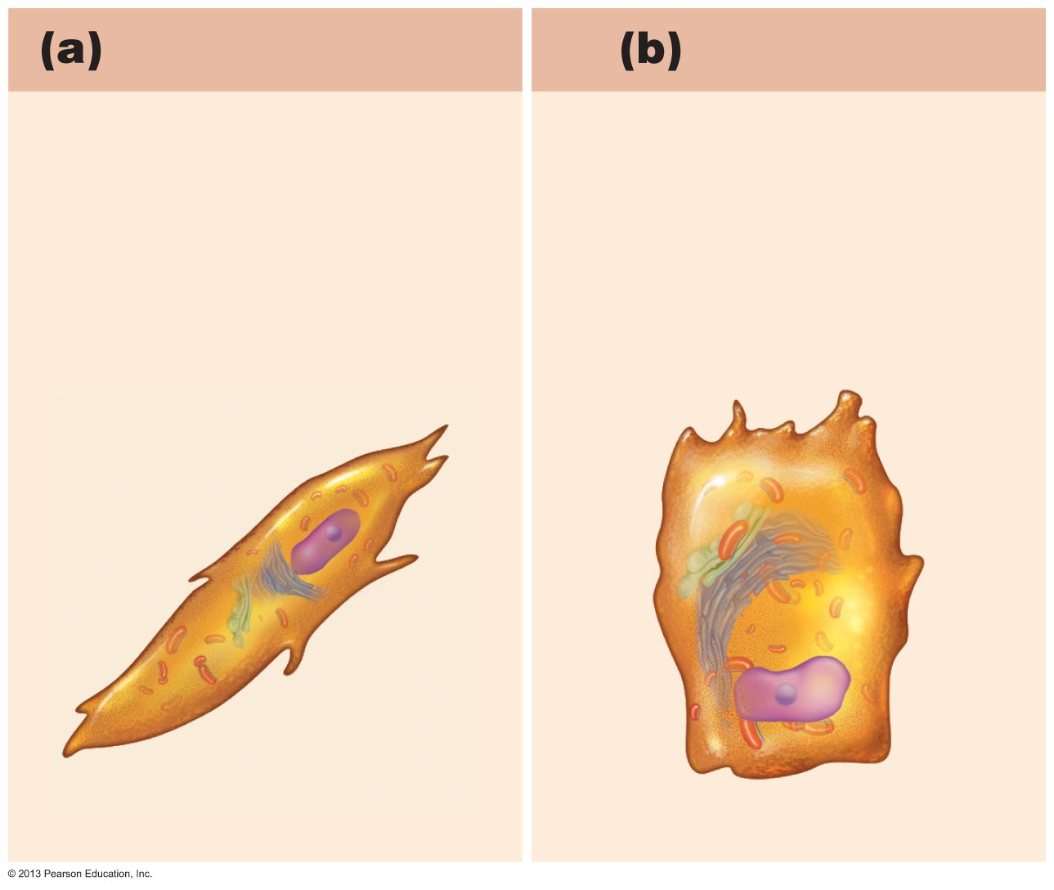
Figure 6.5a–b Comparison of different types of bone cells.
Osteogenic cell
Osteoblast
Stem cell
Matrix-synthesizing
cell responsible for
bone growth
© 2013 Pearson Education, Inc.

Slide 33
Osteocytes
Mature bone cells in lacunae
Monitor and maintain bone matrix
Act as stress or strain sensors
  Respond to and communicate mechanical stimuli to osteoblasts and osteoclasts (cells that destroy bone) so bone remodeling can occur
© 2013 Pearson Education, Inc.

Slide 34
Bone Lining Cells
Flat cells on bone surfaces believed to help maintain matrix
On external bone surface called periosteal cells
Lining internal surfaces called endosteal cells
© 2013 Pearson Education, Inc.

Slide 35
Osteoclasts
Derived from hematopoietic stem cells that become macrophages
Giant, multinucleate cells for bone resorption
When active rest in resorption bay and have ruffled border
  Ruffled border increases surface area for enzyme degradation of bone and seals off area from surrounding matrix
© 2013 Pearson Education, Inc.

Slide 36
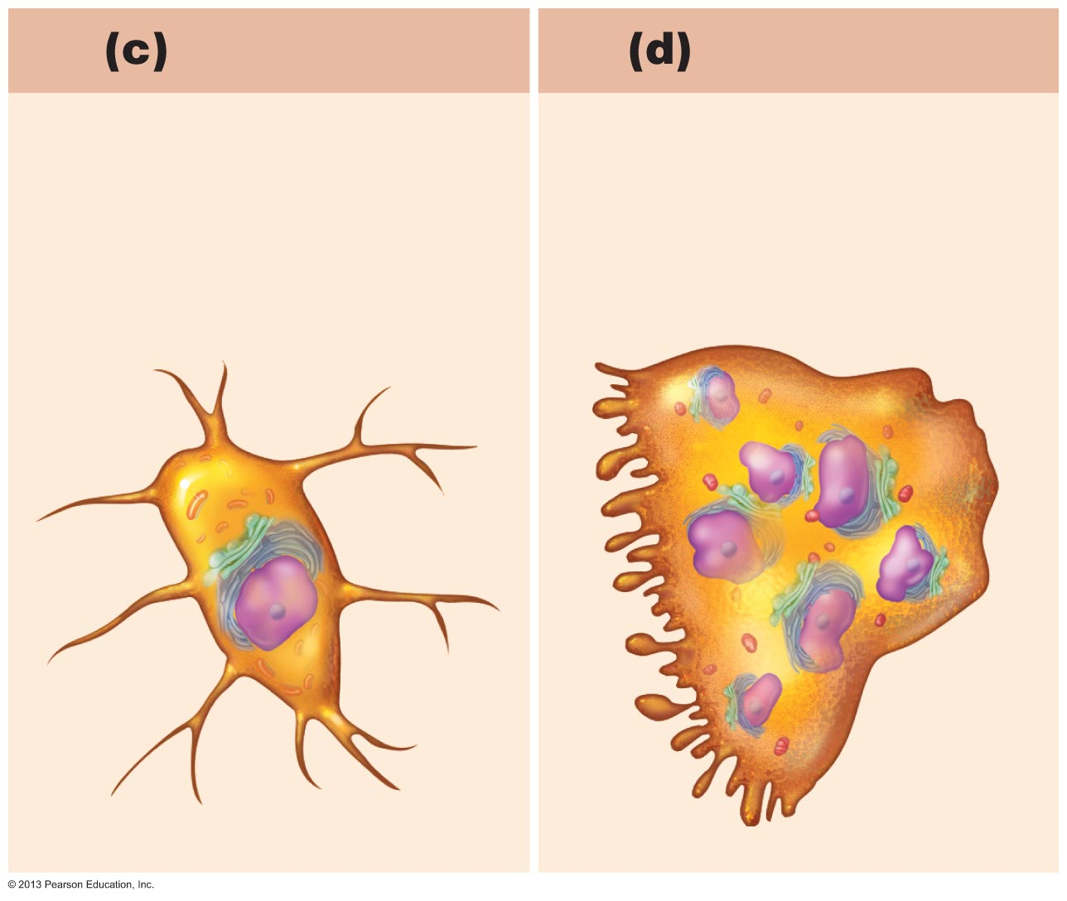
Figure 6.5c–d Comparison of different types of bone cells.
Osteocyte
Osteoclast
Mature bone cell
that monitors and
maintains the
mineralized bone
matrix
Bone-resorbing cell
© 2013 Pearson Education, Inc.

Slide 37
Microscopic Anatomy of Bone:
Compact Bone
Also called lamellar bone
Osteon or Haversian system
  Structural unit of compact bone
  Elongated cylinder parallel to long axis of bone
  Hollow tubes of bone matrix called lamellae
    Collagen fibers in adjacent rings run in different directions
      Withstands stress – resist twisting
© 2013 Pearson Education, Inc.

Slide 38
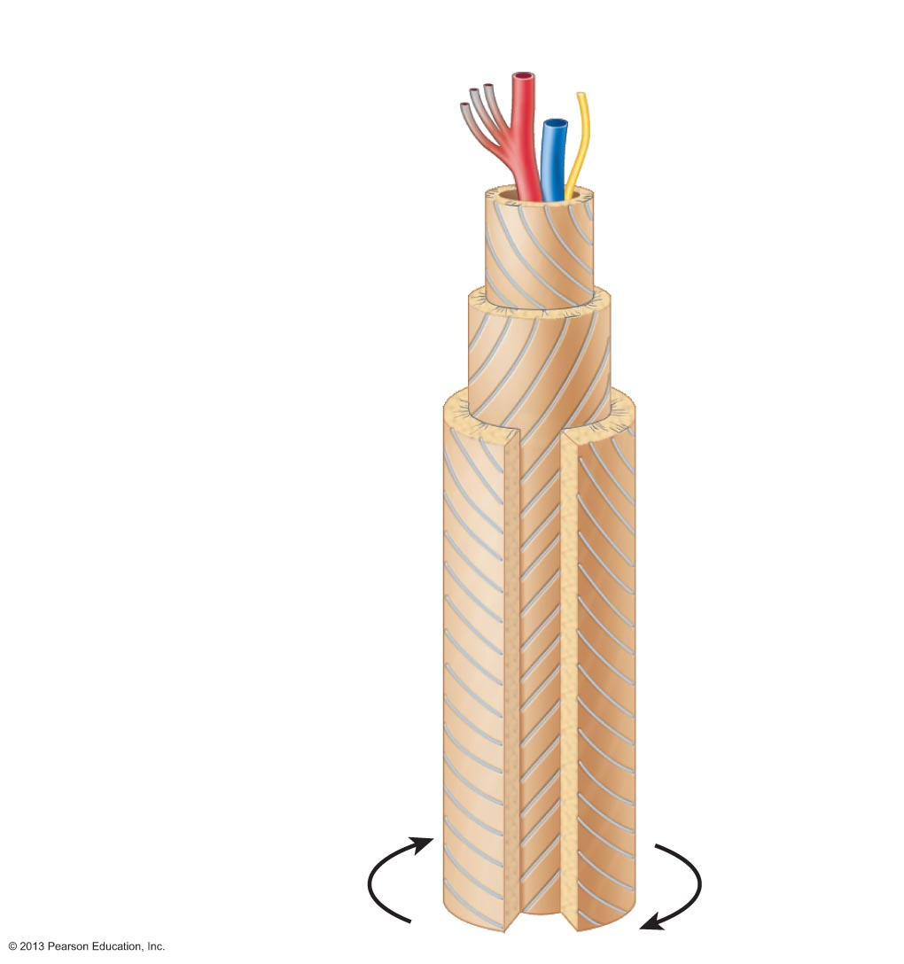
Figure 6.6 A single osteon.
Artery with
capillaries
Structures
in the
central
canal
Vein
Nerve fiber
Lamellae
Collagen
fibers
run in
different
directions
Twisting
force
© 2013 Pearson Education, Inc.

Slide 39
Microscopic Anatomy of Bone: Compact Bone
Canals and canaliculi细管
  Central (Haversian) canal runs through core of osteon
    Contains blood vessels and nerve fibers
Perforating 穿孔性的 (Volkmann's) canals
  Canals lined with endosteum at right angles to central canal
  Connect blood vessels and nerves of periosteum, medullary cavity, and central canal
Lacunae—small cavities that contain osteocytes
Canaliculi—hairlike canals that connect lacunae to each other and central canal
© 2013 Pearson Education, Inc.

Slide 40
Canaliculi Formation
Osteoblasts secreting bone matrix maintain contact with each other and osteocytes via cell projections with gap junctions
When matrix hardens and cells are trapped the canaliculi form
  Allow communication
  Permit nutrients and wastes to be relayed from one osteocyte to another throughout osteon
© 2013 Pearson Education, Inc.

Slide 41
Lamellae
Interstitial lamellae
  Incomplete lamellae not part of complete osteon
  Fill gaps between forming osteons
  Remnants of osteons cut by bone remodeling
Circumferential lamellae
  Just deep to periosteum
  Superficial to endosteum
  Extend around entire surface of diaphysis
  Resist twisting of long bone
© 2013 Pearson Education, Inc.

Slide 42
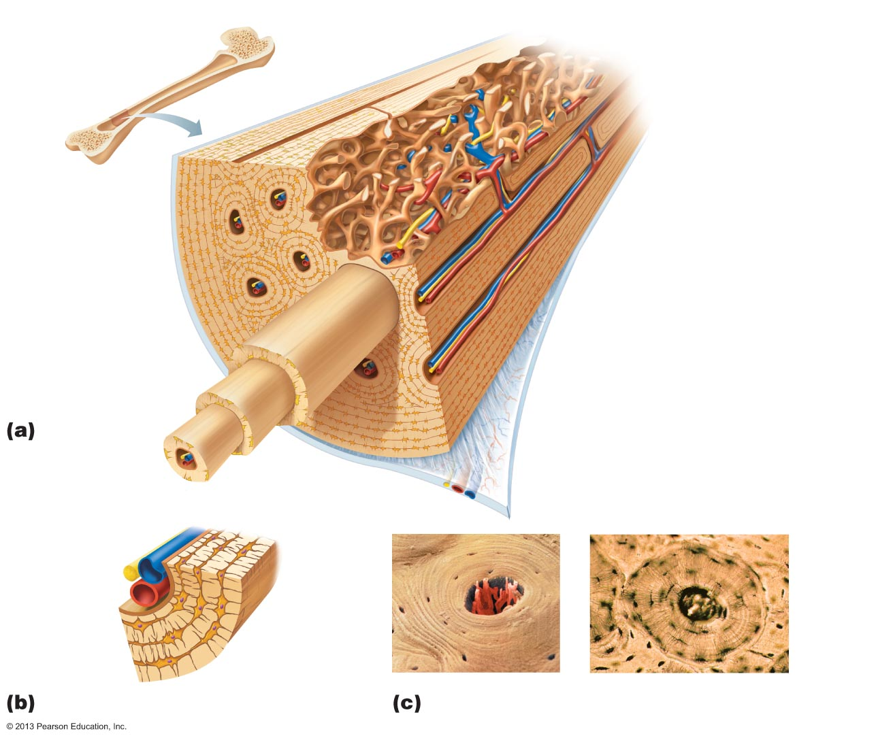
Figure 6.7 Microscopic anatomy of compact bone.
Compact bone
Spongy bone
Central
(Haversian) canal
Perforating
(Volkmann’s) canal
Osteon
(Haversian system)
Endosteum lining bony canals
and covering trabeculae
Circumferential
lamellae
Perforating (Sharpey’s) fibers
Lamellae
Periosteal blood vessel
Periosteum
Nerve
Vein
Lamellae
Artery
Canaliculi
Central
canal
Osteocyte
in a lacuna
Lacunae
Interstitial
lamella
Lacuna
(with osteocyte)
© 2013 Pearson Education, Inc.

Slide 43
Microscopic Anatomy of Bone:
Spongy Bone
Appears poorly organized
Trabeculae
  Align along lines of stress to help resist it
  No osteons
  Contain irregularly arranged lamellae and osteocytes interconnected by canaliculi
  Capillaries in endosteum supply n utrients
© 2013 Pearson Education, Inc.

Slide 44
Chemical Composition of Bone: Organic Components
Includes cells and osteoid
  Osteogenic cells, osteoblasts, osteocytes, bone- lining cells, and osteoclasts
  Osteoid—1/3 of organic bone matrix secreted by osteoblasts
    Made of ground substance (proteoglycans and glycoproteins)
    Collagen fibers
    Contributes to structure; provides tensile strength and flexibility
Resilience 弹性 of bone due to sacrificial bonds in or between collagen molecules
  Stretch and break easily on impact to dissipate energy and prevent fracture
  If no addition trauma, bonds re-form
© 2013 Pearson Education, Inc.

Slide 45
Chemical Composition of Bone:
Inorganic Components
Hydroxyapatites (mineral salts)
  65% of bone by mass
  Mainly of tiny calcium phosphate 磷肥 crystals in and around collagen fibers
  Responsible for hardness and resistance to compression
© 2013 Pearson Education, Inc.

Slide 46
Bone
Half as strong as steel in resisting compression
As strong as steel in resisting tension
Last long after death because of mineral composition
  Reveal information about ancient people
  Can display growth arrest lines
    Horizontal lines on bones
    Proof of illness - when bones stop growing so nutrients can help fight disease
© 2013 Pearson Education, Inc.

